Slide 1

PLANT
PLACEMENT ANALYZER
Mike Brigham
Michael McClung
Alexandre Soares
Nicholas Volberding

Slide 2
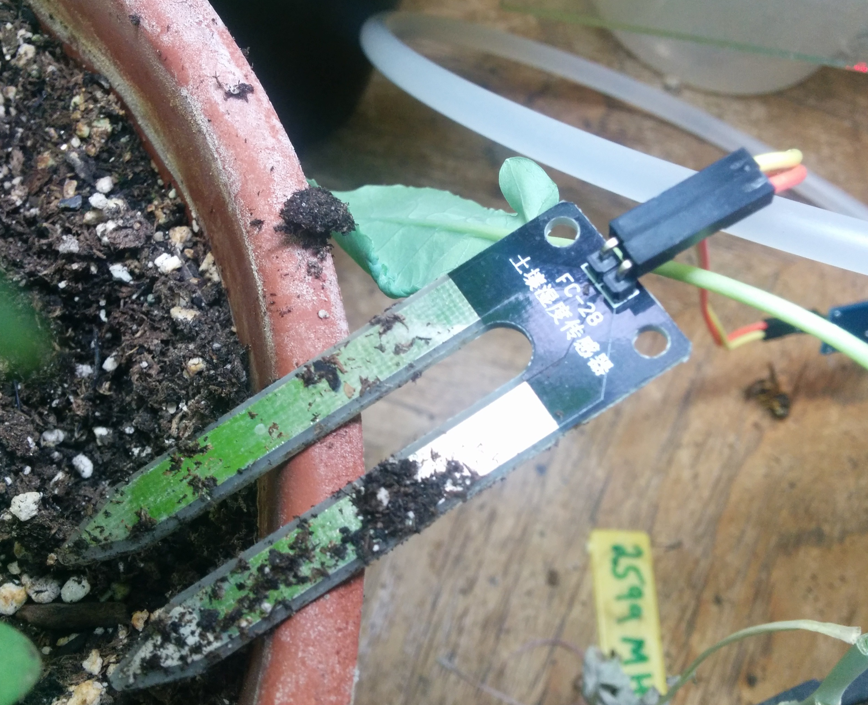
Problem Statement
Plants need MORE than fertilizer:
Light;
Water in the soil;
Appropriate Climate;
Project: monitors all these environmental factors AND makes recommendations to user

Slide 3
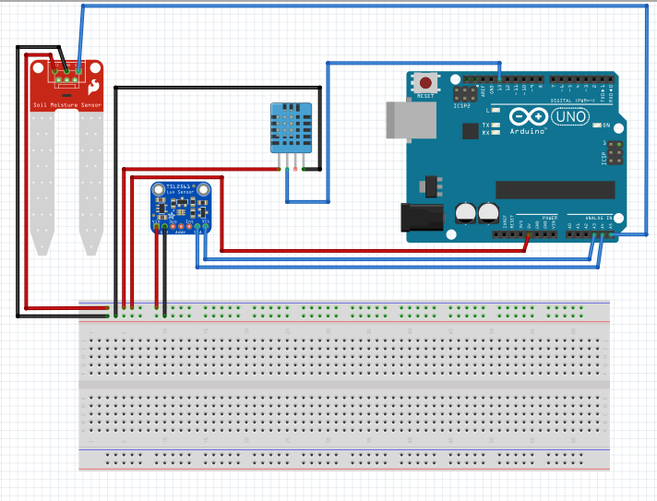
Technical Approach
Sensors
Light
Soil Moisture
Air Humidity
Code
arrays and if/else’s
Correct units
GUI

Slide 4
Technical Approach
Soil moisture sensor
Temperature/
Air humidity sensor
UV sensor
LCD
Shows plants’ names and arrows < > Enter
User
Breadboard
2 Buttons – input:
< > Enter
Computer – C++ Arduino IDE
(code uploaded)
Arduino

Slide 5
Beyond Internet Projects
perform generally one task
Not a combination of sensors
Ours: combination of sensors
Project contained in a casing for portability and safety.

Slide 6
Individual Contributions
MIKE | 3D Printed Casing/ Draft Code
ALEX | Powerpoint Final/ Organizing Code/Unit conversions
MICHAEL | Button Coding / Powerpoint Draft
NICK | Researching Data for Project / Implementation of Data in Code

Slide 7
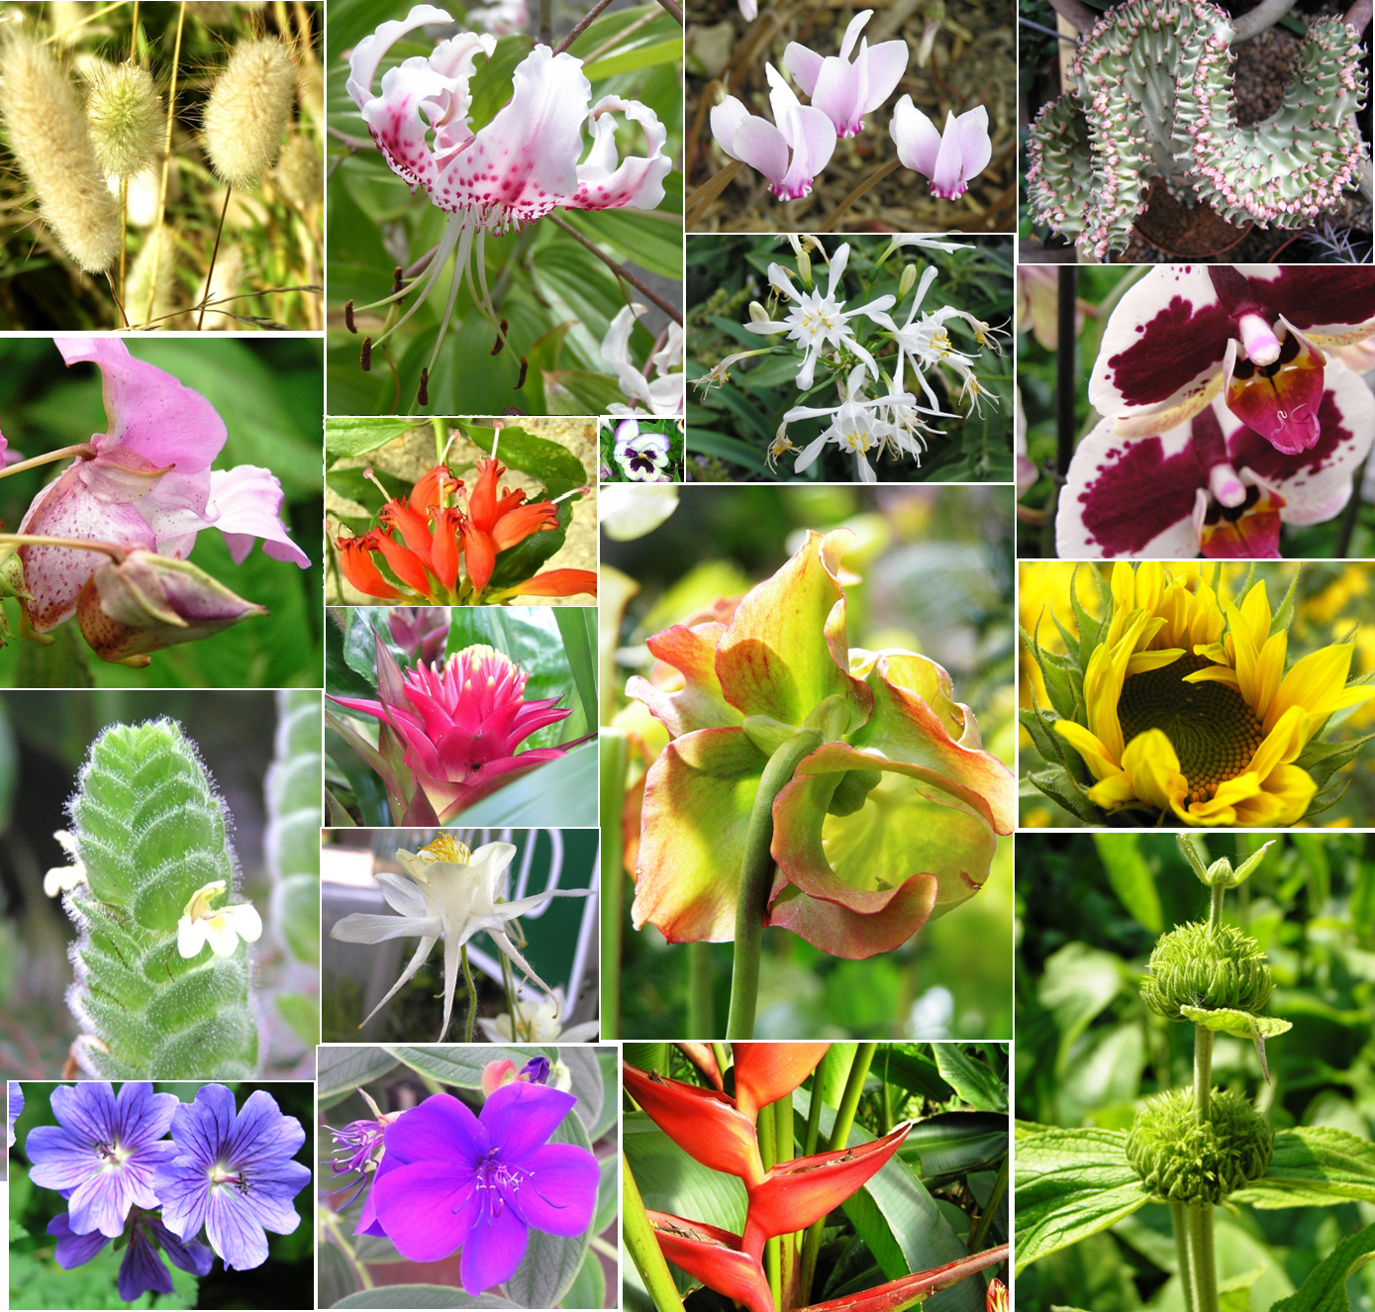
Done to Date
Drafted code
Defined data ranges
Purchased sensors
Small list of plans with appropriate units
TO BE DONE NEXT
Assemble and test sensors
More unit conversion for plant species – there’s a lot of them!
Develop a GUI – if practical (display/buttons)
Create ’Unit’ in the for of a casing for our project

Slide 8
Budget to Date
Temperature and humidity sensor | $2
Soil moisture sensor | $3
UV light sensor | $10
Breadboard | $7
Arduino board/ wires | $15
Presentation plant (maybe) | $10
TOTAL so far |$47

Slide 9

Thank you!

